Slide 1
Louisiana Purchase
Jefferson’s Legacy

Slide 2
Before 1803...
Western portion of North America was owned and controlled by France.
Before the Lewis & Clark Expedition this area was occupied by;
Native American peoples
French fur trappers
American fur trappers - Like Hugh Glass or Jim Bridger!!!

Slide 3
Tribal Lands before 1803
http://www.npr.org/assets/news/2014/06/Tribal_Nations_Map_NA.pdf
Found at NPR

Slide 4
Jefferson’s Legacy
Originally only wanted New Orleans for the port…
BUT ended up with over 828,000 square miles of land.
Paid only $15 million… That’s less than 3 cents per acre!
Officially purchased in 1803
But was this constitutional?
Notes:
Why would Jefferson be so interested in New Orleans?

Slide 5
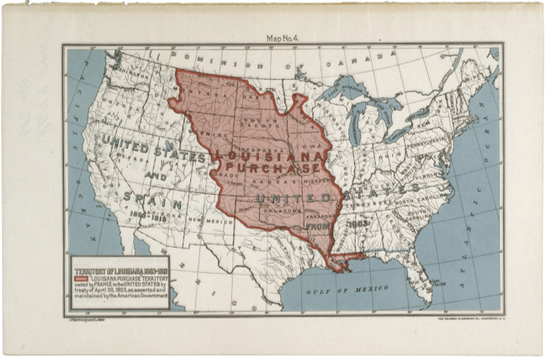
Map of the Louisiana Purchase
Created in 1902
Found at DocsTeach.gov

Slide 6
Impact
Why was/is the Louisiana Purchase important?
What did it allow?

