Slide 1
The Importance of Rigorous Research
A National History Day Example:
State Competition 2011

Slide 2
State NHD Junior Division Exhibit Hall
Some of Delta Middle Schools best students: Linh, Chastin, Cade, and Jacob

Slide 3
Academic Competitions Work!
Link to the results of a NHD study on its effectiveness: NHD Study Results

Slide 4
Moving from preliminary to final judging
The 2010-2011 theme was:
Debate and Diplomacy -
Successes, Failures, and Consequences
The 2011-2012 theme is:
Revolution, Reaction, and
Reform in History
The 201- 2013 theme is:
Turning Points in History -
People, Ideas, Events

Slide 5
Amache: Colorado’s Concentration Camp

Slide 6
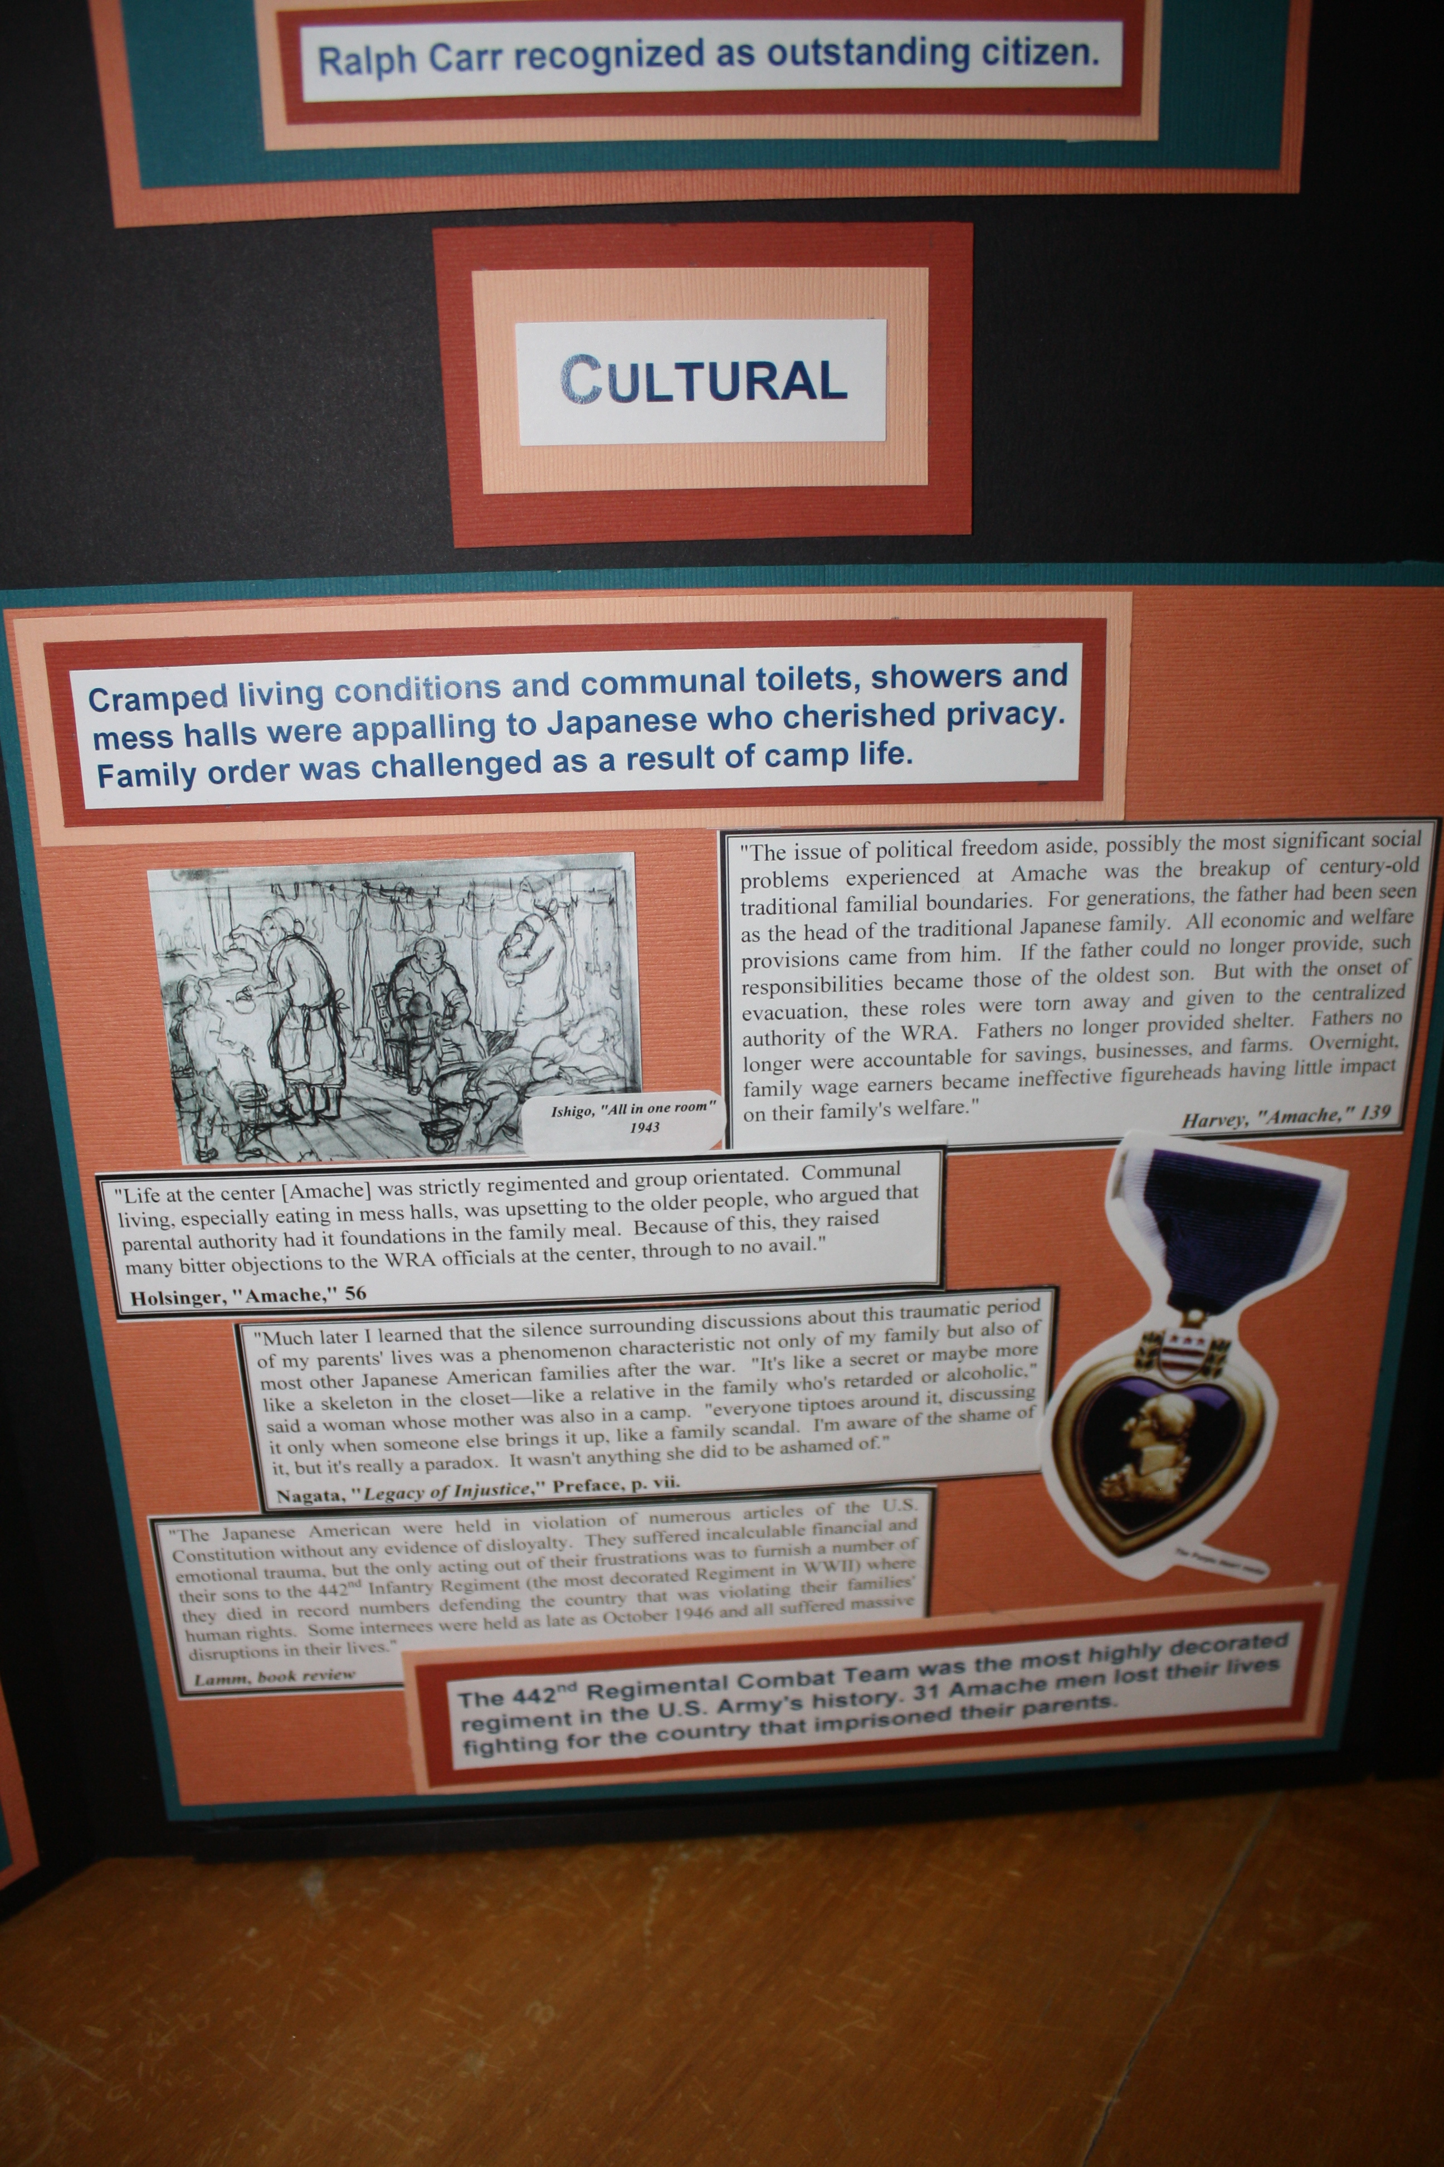
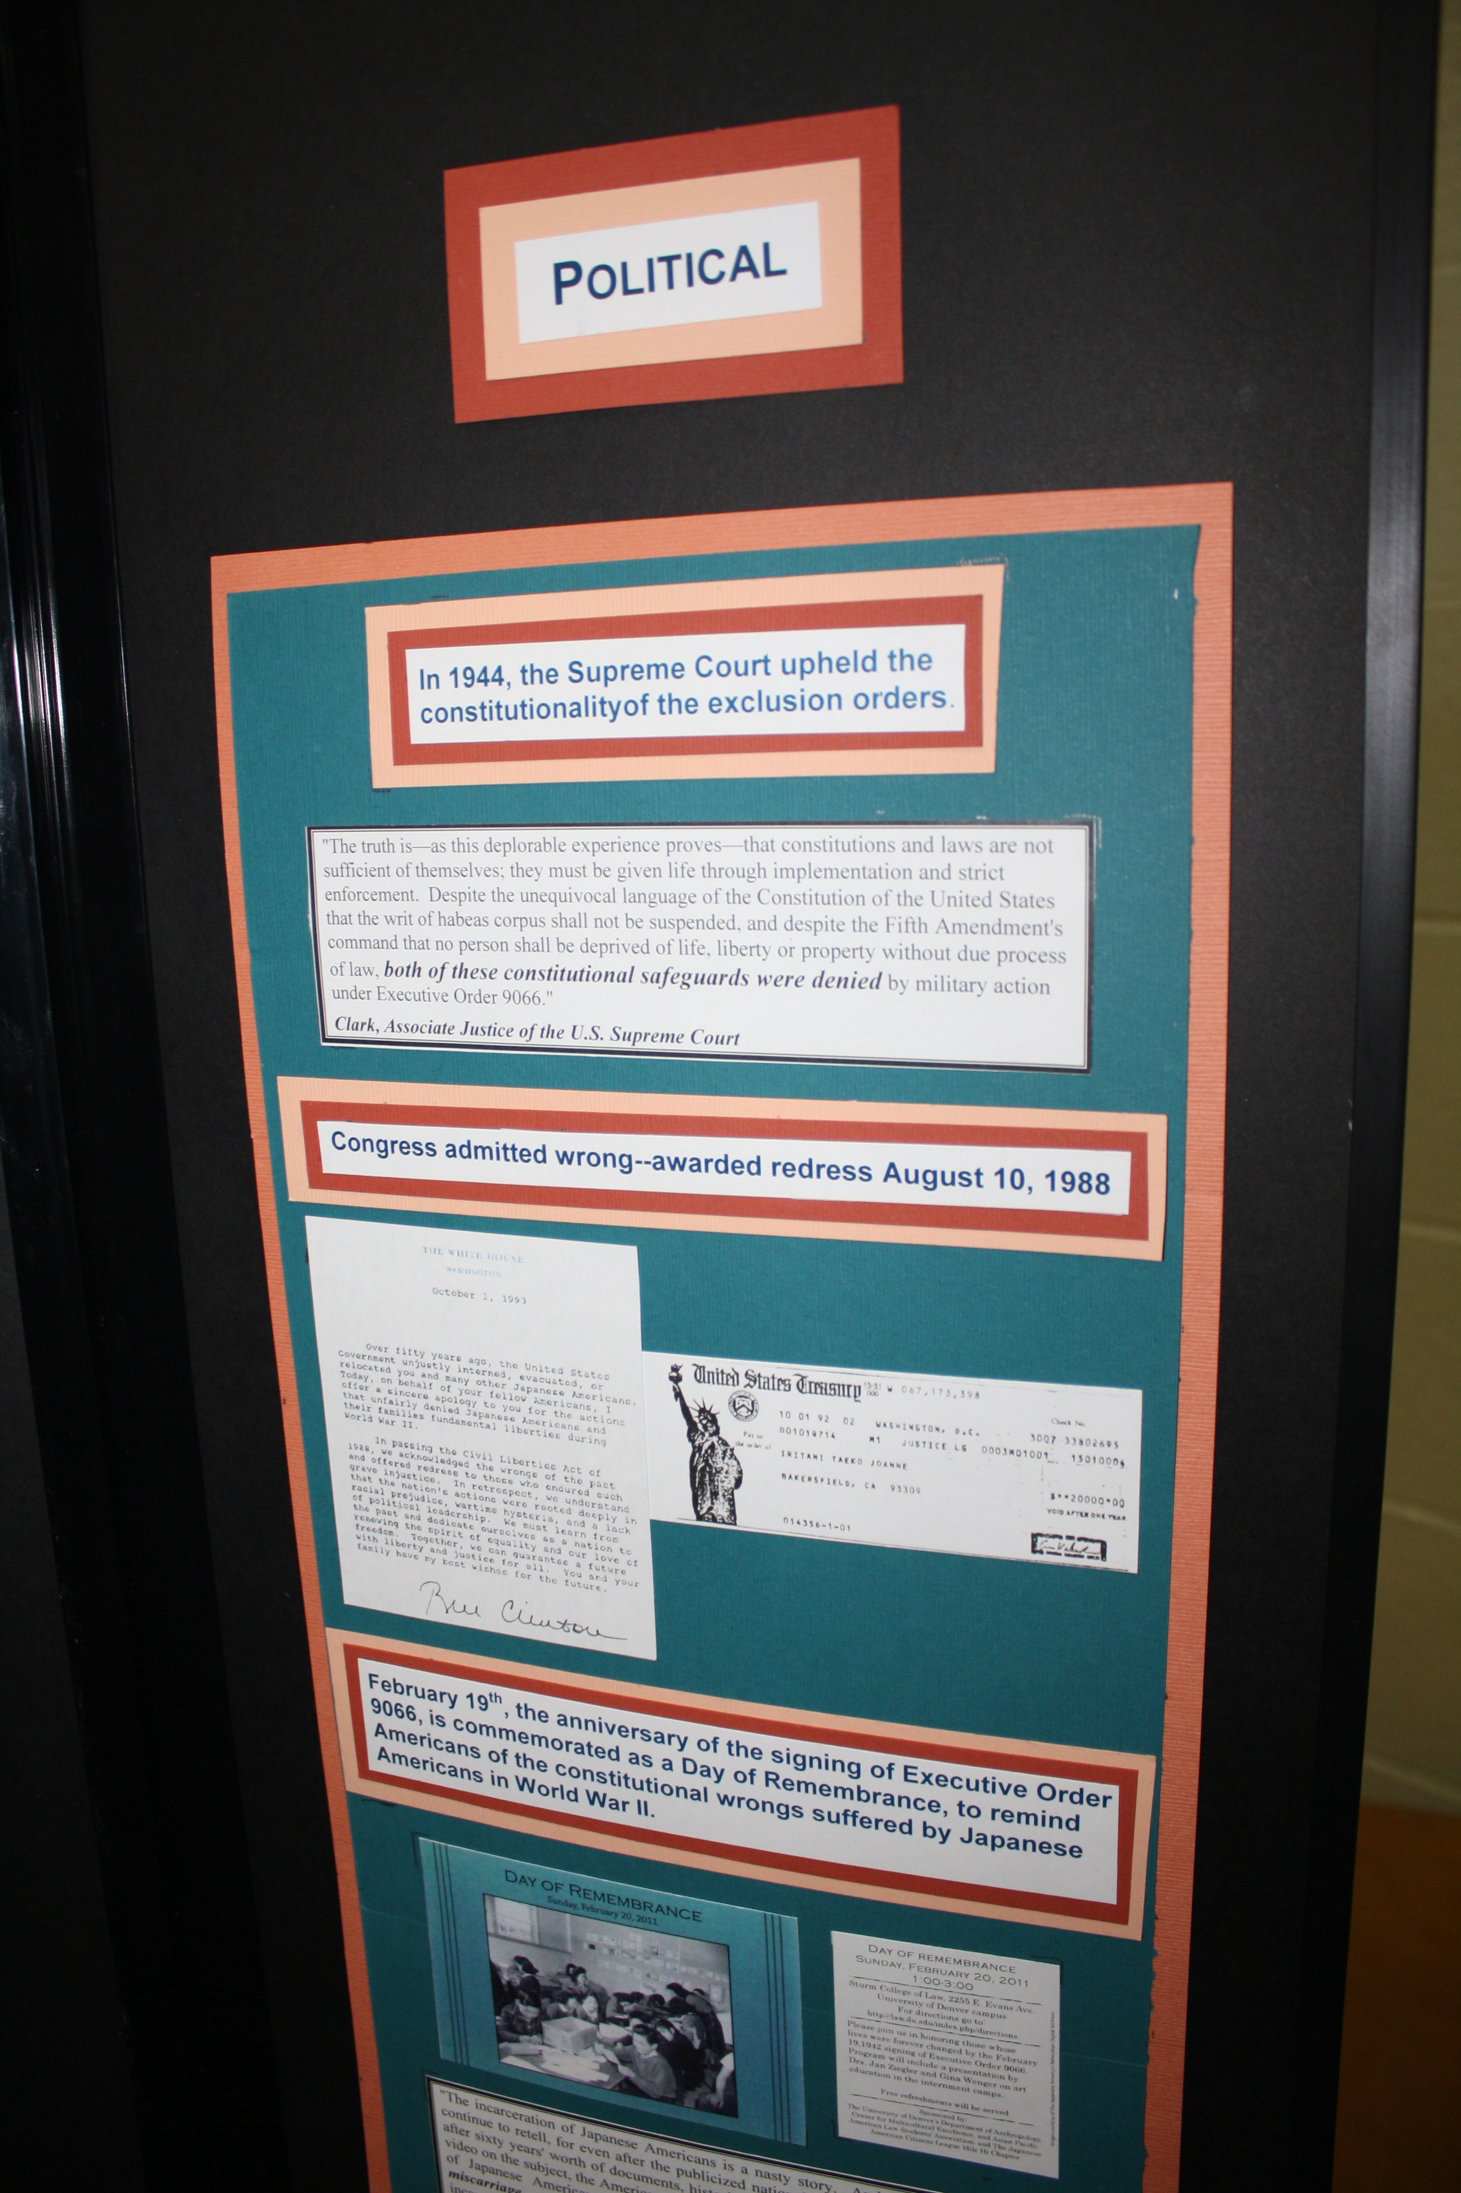
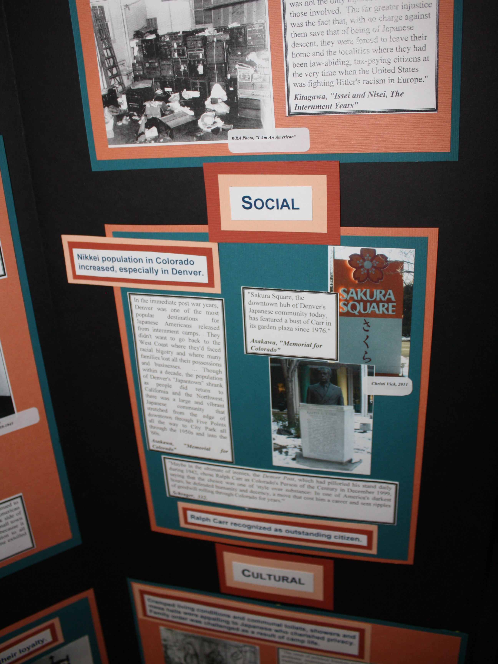
Analysis of topic Economically, Socially, Culturally, Politically

Slide 7
A Middle School Annotated Bibliography

Slide 8
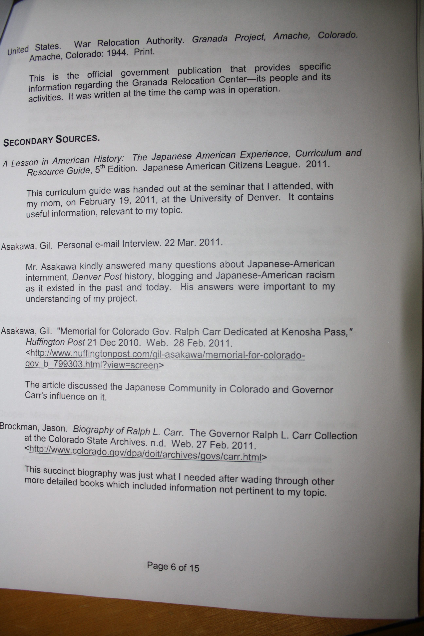
Annotated Bibliography Continued

Slide 9
Preserving the Land

Slide 10
Harriet Beecher Stowe and the Book that Declared War

Slide 11
The Cuban Missile Crisis

Slide 12
Running Wild: the Debate Behind Prohibition

Slide 13
So what do we do now…
Introduce a Research Process that is rigorous, develops 21st Century Skills, and guides students, so that they can compete in Academic Competitions.
As a school we need to make sure the Research Process is clear, and that teachers consistently use the process.
As a school we need to continue learning ourselves, and pool together our resources.

Slide 14
The Delta County School District Research Process at the Middle Level
OBJECTIVE:
TEACHERS WILL BE ABLE TO (TWBAT) GUIDE STUDENTS IN CONDUCTING LEGITIMATE, IN-DEPTH RESEARCH THAT IS RELEVANT TO CURRICULUM,
And ACADEMIC COMPETITIONS

Slide 15
The Research Process Explained: THE PROCESS
6-8th grade standards.doc
The Research Process at Delta Middle School.doc
8th Grade Research Scoring Guide.doc
7th Grade Research Scoring Guide.doc
6th Grade Research Scoring Guide.doc
RESEARCH MATRIS.xls

Slide 16
The Research Process Explained: RUBRICS
8th Grade Nonfiction Extended Response Scoring Guide.doc
7th Grade Nonfiction Extended Response Scoring Guide.doc
6th Grade Nonfiction Extended Response Scoring Guide.doc
The DMS Scoring Guides prepare students to compete in National History Day, Science Fair, Project Citizen, and national essay competitions. This is the start of a rigorous research process, however, students who compete will most likely have to do EVEN MORE research in order to move to state and national levels! See the NHD scoring guides in the Unit Template or go to www.nhd.org

Slide 17
The Research Process Explained: RESOURCES AND WORKS CITED
Works Cited: MLA*, APA*, Chicago, Turabian… etc.
Updated MLA PowerPoint: MLA citations.ppt
Purdue OWL Research Lab (and source for citations)
http://owl.english.purdue.edu/
Academic Sources to begin research ** NO WIKIPEDIA**
nonfiction Resources for Research.doc
How to Evaluate a website
Evaluating Web Sites.pdf
Evaluating Web Sites pg2.pdf
Working with Sources HANDOUT.pdf

Slide 18
The Research Process Explained: NOTE TAKING
SourceCards.doc
NotecardExemplar.doc
Beginning Research handout.pdf
Research Strategy Worksheet.pdf
Testing Your Thesis handout.pdf

Slide 19
The Research Process Explained: PRIMARY VS SECONDARY SOURCES
Understanding Primary and Secondary Sources - for techers.pdf
Identifying Primary and Secondary Sources.pdf
Primary and Secondary Sources.pdf
Paraphrasing, Summarizing, and Quoting.pdf
Prewriting a multiple paragraph essay pg1.pdf
Formatting Rules for Both Essay and Works Cited Page.doc

Slide 20
Thank you…
Teachers who helped create this process in June 2011:
Connie Davidson, Jennifer Magner,
and Debbie Salcedo
We need to continue to revise and add to this process, but DO NOT just ignore it. Read the article below for incentive to participate in National History Day, and rigorous research processes:
file://localhost/Norm Augustine/ The Education Our Economy Needs - WSJ.com.pdf

